Slide 1
CHAPTER 2
ARTIFICIAL NEURAL NETWORKS: AN INTRODUCTION
“Principles of Soft Computing, 2nd Edition”
by S.N. Sivanandam & SN Deepa
Copyright © 2011 Wiley India Pvt. Ltd. All rights reserved.

Slide 2
DEFINITION OF NEURAL NETWORKS
According to the DARPA Neural Network Study (1988, AFCEA International Press, p. 60):
• ... a neural network is a system composed of many simple processing elements operating in parallel whose function is determined by network structure, connection strengths, and the processing performed at computing elements or nodes.
According to Haykin (1994), p. 2:
A neural network is a massively parallel distributed processor that has a natural propensity for storing experiential knowledge and making it available for use. It resembles the brain in two respects:
Knowledge is acquired by the network through a learning process.
Interneuron connection strengths known as synaptic weights are used to store the knowledge.
“Principles of Soft Computing, 2nd Edition”
by S.N. Sivanandam & SN Deepa
Copyright © 2011 Wiley India Pvt. Ltd. All rights reserved.

Slide 3
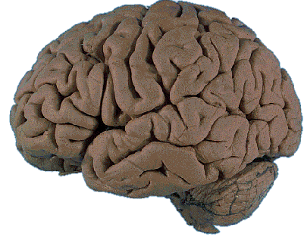
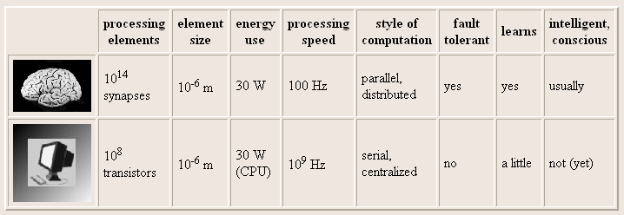
BRAIN COMPUTATION
The human brain contains about 10 billion nerve cells, or neurons. On average, each neuron is connected to other neurons through approximately 10,000 synapses.
“Principles of Soft Computing, 2nd Edition”
by S.N. Sivanandam & SN Deepa
Copyright © 2011 Wiley India Pvt. Ltd. All rights reserved.

Slide 4
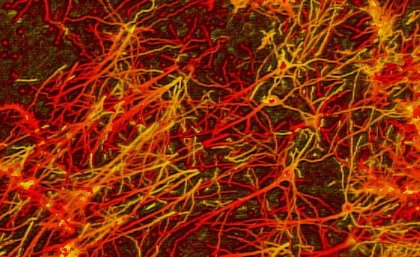
INTERCONNECTIONS IN BRAIN
“Principles of Soft Computing, 2nd Edition”
by S.N. Sivanandam & SN Deepa
Copyright © 2011 Wiley India Pvt. Ltd. All rights reserved.

Slide 5
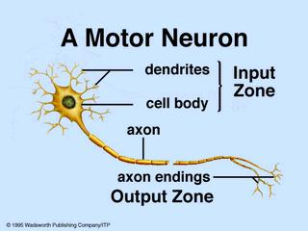
BIOLOGICAL (MOTOR) NEURON
“Principles of Soft Computing, 2nd Edition”
by S.N. Sivanandam & SN Deepa
Copyright © 2011 Wiley India Pvt. Ltd. All rights reserved.

Slide 6
ARTIFICIAL NEURAL NET
Information-processing system.
Neurons process the information.
The signals are transmitted by means of connection links.
The links possess an associated weight.
The output signal is obtained by applying activations to the net input.
“Principles of Soft Computing, 2nd Edition”
by S.N. Sivanandam & SN Deepa
Copyright © 2011 Wiley India Pvt. Ltd. All rights reserved.

Slide 7
MOTIVATION FOR NEURAL NET
  Scientists are challenged to use machines more effectively for tasks currently solved by humans.
  Symbolic rules don't reflect processes actually used by humans.
  Traditional computing excels in many areas, but not in others.
“Principles of Soft Computing, 2nd Edition”
by S.N. Sivanandam & SN Deepa
Copyright © 2011 Wiley India Pvt. Ltd. All rights reserved.

Slide 8
  The major areas being:
  Massive parallelism
  Distributed representation and computation
  Learning ability
  Generalization ability
  Adaptivity
  Inherent contextual information processing
  Fault tolerance
  Low energy consumption.
“Principles of Soft Computing, 2nd Edition”
by S.N. Sivanandam & SN Deepa
Copyright © 2011 Wiley India Pvt. Ltd. All rights reserved.

Slide 9
ARTIFICIAL NEURAL NET
W₁
X₁
Y
W₂
X₂
The figure shows a simple artificial neural net with two input neurons (X₁, X₂) and one output neuron (Y). The inter connected weights are given by W₁ and W₂.
“Principles of Soft Computing, 2nd Edition”
by S.N. Sivanandam & SN Deepa
Copyright © 2011 Wiley India Pvt. Ltd. All rights reserved.

Slide 10
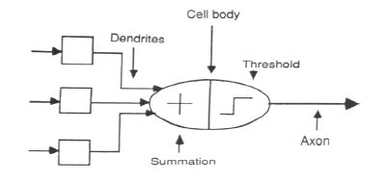
ASSOCIATION OF BIOLOGICAL NET
WITH ARTIFICIAL NET
“Principles of Soft Computing, 2nd Edition”
by S.N. Sivanandam & SN Deepa
Copyright © 2011 Wiley India Pvt. Ltd. All rights reserved.

Slide 11
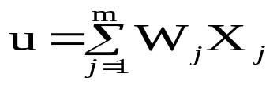

PROCESSING OF AN ARTIFICIAL NET
The neuron is the basic information processing unit of a NN. It consists of:
1. A set of links, describing the neuron inputs, with weights W₁, W₂, …, W_{m}.
2. An adder function (linear combiner) for computing the weighted sum of the inputs (real numbers):
3. Activation function for limiting the amplitude of the neuron output.
“Principles of Soft Computing, 2nd Edition”
by S.N. Sivanandam & SN Deepa
Copyright © 2011 Wiley India Pvt. Ltd. All rights reserved.

Slide 12
BIAS OF AN ARTIFICIAL NEURON
The bias value is added to the weighted sum
∑w_{i}x_{i} so that we can transform it from the origin.
Y_{in} = ∑w_{i}x_{i} + b, where b is the bias
x₁-x₂= -1
x₂
x₁-x₂=0
x₁-x₂= 1
x₁
“Principles of Soft Computing, 2nd Edition”
by S.N. Sivanandam & SN Deepa
Copyright © 2011 Wiley India Pvt. Ltd. All rights reserved.

Slide 13
MULTI LAYER ARTIFICIAL NEURAL NET
INPUT: records without class attribute with normalized attributes values.
INPUT VECTOR: X = { x₁, x₂, …, x_{n}} where n is the number of (non-class) attributes.
INPUT LAYER: there are as many nodes as non-class attributes, i.e. as the length of the input vector.
HIDDEN LAYER: the number of nodes in the hidden layer and the number of hidden layers depends on implementation.
“Principles of Soft Computing, 2nd Edition”
by S.N. Sivanandam & SN Deepa
Copyright © 2011 Wiley India Pvt. Ltd. All rights reserved.

Slide 14
OPERATION OF A NEURAL NET
-
Bias
x₀
w_{0j}
x₁
w_{1j}
∑
f
Output y
x_{n}
w_{nj}
Input
vector x
Weight
vector w
Weighted
sum
Activation
function
“Principles of Soft Computing, 2nd Edition”
by S.N. Sivanandam & SN Deepa
Copyright © 2011 Wiley India Pvt. Ltd. All rights reserved.

Slide 15
WEIGHT AND BIAS UPDATION
Per Sample Updating
updating weights and biases after the presentation of each sample.
Per Training Set Updating (Epoch or Iteration)
weight and bias increments could be accumulated in variables and the weights and biases updated after all the samples of the training set have been presented.
“Principles of Soft Computing, 2nd Edition”
by S.N. Sivanandam & SN Deepa
Copyright © 2011 Wiley India Pvt. Ltd. All rights reserved.

Slide 16
STOPPING CONDITION
All change in weights (Δwij) in the previous epoch are below some threshold, or
The percentage of samples misclassified in the previous epoch is below some threshold, or
A pre-specified number of epochs has expired.
In practice, several hundreds of thousands of epochs may be required before the weights will converge.
“Principles of Soft Computing, 2nd Edition”
by S.N. Sivanandam & SN Deepa
Copyright © 2011 Wiley India Pvt. Ltd. All rights reserved.

Slide 17
BUILDING BLOCKS OF ARTIFICIAL NEURAL NET
Network Architecture (Connection between Neurons)
Setting the Weights (Training)
Activation Function
“Principles of Soft Computing, 2nd Edition”
by S.N. Sivanandam & SN Deepa
Copyright © 2011 Wiley India Pvt. Ltd. All rights reserved.

Slide 18
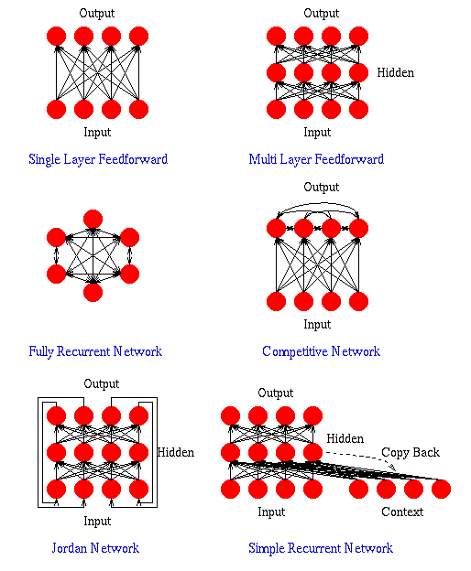
“Principles of Soft Computing, 2nd Edition”
by S.N. Sivanandam & SN Deepa
Copyright © 2011 Wiley India Pvt. Ltd. All rights reserved.

Slide 19
LAYER PROPERTIES
Input Layer: Each input unit may be designated by an attribute value possessed by the instance.
Hidden Layer: Not directly observable, provides nonlinearities for the network.
Output Layer: Encodes possible values.
“Principles of Soft Computing, 2nd Edition”
by S.N. Sivanandam & SN Deepa
Copyright © 2011 Wiley India Pvt. Ltd. All rights reserved.

Slide 20
TRAINING PROCESS
Supervised Training - Providing the network with a series of sample inputs and comparing the output with the expected responses.
Unsupervised Training - Most similar input vector is assigned to the same output unit.
Reinforcement Training - Right answer is not provided but indication of whether ‘right’ or ‘wrong’ is provided.
“Principles of Soft Computing, 2nd Edition”
by S.N. Sivanandam & SN Deepa
Copyright © 2011 Wiley India Pvt. Ltd. All rights reserved.

Slide 21
ACTIVATION FUNCTION
ACTIVATION LEVEL – DISCRETE OR CONTINUOUS
HARD LIMIT FUCNTION (DISCRETE)
    Binary Activation function
    Bipolar activation function
    Identity function
SIGMOIDAL ACTIVATION FUNCTION (CONTINUOUS)
    Binary Sigmoidal activation function
    Bipolar Sigmoidal activation function
“Principles of Soft Computing, 2nd Edition”
by S.N. Sivanandam & SN Deepa
Copyright © 2011 Wiley India Pvt. Ltd. All rights reserved.

Slide 22
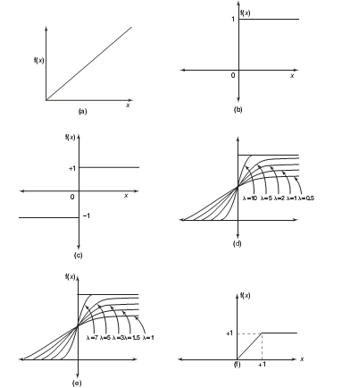
ACTIVATION FUNCTION
Activation functions:
(A) Identity
(B) Binary step
(C) Bipolar step
(D) Binary sigmoidal
(E) Bipolar sigmoidal
(F) Ramp
“Principles of Soft Computing, 2nd Edition”
by S.N. Sivanandam & SN Deepa
Copyright © 2011 Wiley India Pvt. Ltd. All rights reserved.

Slide 23
CONSTRUCTING ANN
Determine the network properties:
  Network topology
  Types of connectivity
  Order of connections
  Weight range
Determine the node properties:
  Activation range
Determine the system dynamics
  Weight initialization scheme
  Activation – calculating formula
  Learning rule
“Principles of Soft Computing, 2nd Edition”
by S.N. Sivanandam & SN Deepa
Copyright © 2011 Wiley India Pvt. Ltd. All rights reserved.

Slide 24
PROBLEM SOLVING
Select a suitable NN model based on the nature of the problem.
Construct a NN according to the characteristics of the application domain.
Train the neural network with the learning procedure of the selected model.
Use the trained network for making inference or solving problems.
“Principles of Soft Computing, 2nd Edition”
by S.N. Sivanandam & SN Deepa
Copyright © 2011 Wiley India Pvt. Ltd. All rights reserved.

Slide 25
NEURAL NETWORKS
Neural Network learns by adjusting the weights so as to be able to correctly classify the training data and hence, after testing phase, to classify unknown data.
Neural Network needs long time for training.
Neural Network has a high tolerance to noisy and incomplete data.
“Principles of Soft Computing, 2nd Edition”
by S.N. Sivanandam & SN Deepa
Copyright © 2011 Wiley India Pvt. Ltd. All rights reserved.

Slide 26
SALIENT FEATURES OF ANN
Adaptive learning
Self-organization
Real-time operation
Fault tolerance via redundant information coding
Massive parallelism
Learning and generalizing ability
Distributed representation
“Principles of Soft Computing, 2nd Edition”
by S.N. Sivanandam & SN Deepa
Copyright © 2011 Wiley India Pvt. Ltd. All rights reserved.

Slide 27
McCULLOCH–PITTS NEURON
Neurons are sparsely and randomly connected
Firing state is binary (1 = firing, 0 = not firing)
All but one neuron are excitatory (tend to increase voltage of other cells)
  One inhibitory neuron connects to all other neurons
  It functions to regulate network activity (prevent too many firings)
“Principles of Soft Computing, 2nd Edition”
by S.N. Sivanandam & SN Deepa
Copyright © 2011 Wiley India Pvt. Ltd. All rights reserved.

Slide 28
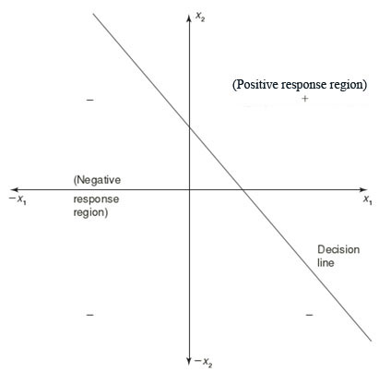
LINEAR SEPARABILITY
Linear separability is the concept wherein the separation of the input space into regions is based on whether the network response is positive or negative.
Consider a network having positive response in the first quadrant and negative response in all other quadrants (AND function) with either binary or bipolar data, then the decision line is drawn separating the positive response region from the negative response region.
“Principles of Soft Computing, 2nd Edition”
by S.N. Sivanandam & SN Deepa
Copyright © 2011 Wiley India Pvt. Ltd. All rights reserved.

Slide 29
HEBB NETWORK
Donald Hebb stated in 1949 that in the brain, the learning is performed by the change in the synaptic gap. Hebb explained it:
“When an axon of cell A is near enough to excite cell B, and repeatedly or permanently takes place in firing it, some growth process or metabolic change takes place in one or both the cells such that A’s efficiency, as one of the cells firing B, is increased.”
“Principles of Soft Computing, 2nd Edition”
by S.N. Sivanandam & SN Deepa
Copyright © 2011 Wiley India Pvt. Ltd. All rights reserved.

Slide 30
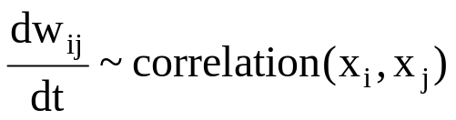
HEBB LEARNING
The weights between neurons whose activities are positively correlated are increased:
Associative memory is produced automatically
The Hebb rule can be used for pattern association, pattern categorization, pattern classification and over a range of other areas.
“Principles of Soft Computing, 2nd Edition”
by S.N. Sivanandam & SN Deepa
Copyright © 2011 Wiley India Pvt. Ltd. All rights reserved.

Slide 31

FEW APPLICATIONS OF NEURAL NETWORKS
“Principles of Soft Computing, 2nd Edition”
by S.N. Sivanandam & SN Deepa
Copyright © 2011 Wiley India Pvt. Ltd. All rights reserved.

